Slide 1
Humanities and engineering
Special Interest Group
SnapPapers
Ramsha Naeem
Harsh Sanjaykumar Pandya
Alejandro Santoscoy Rivero
Sithija Wijesinghe

Slide 2
Features previously added
Landing page
Homepage
Login page
Logout functionality
Profile page
Explore researchers page
Contact form
Visualizations
Word cloud - research interests
Research trends - publications
Geographical visualizations - research work places

Slide 3
Features discussed last meeting
Word cloud - research interests
Make it the banner image
Add interactiveness
Explore researchers page
Display in sections
Filters
Search
Explore research papers / publications page
Add page
Geographical map - researcher locations
Add interactions i.e. filter based on University/workplace.
Bilingual

Slide 4
New features added
Word cloud - research interests
Make it the banner image
Add interactiveness
Explore researchers page
Display in sections
Filters
Search
Explore research papers / publications page
Add page
Geographical map - researcher locations
Add interactions i.e. filter based on University/work place
Navigation bar
Streamlining pages
Making the experience consistent
Improving readability

Slide 5
What we plan next
Profile page
Edit functionality
Streamlining page
Word cloud - research interests
Make the size of words based on the times a keyword is repeated
Explore researchers
Improve search functionality
Bilingual integration
Improving ease of use
Snap scrolling
Improving navigation animation
Improve navigation bar
Registration
Option 1: Administrator creates user login on request
Option 2: User creates profile and administrator approves/rejects
Forums
Connections

Slide 6
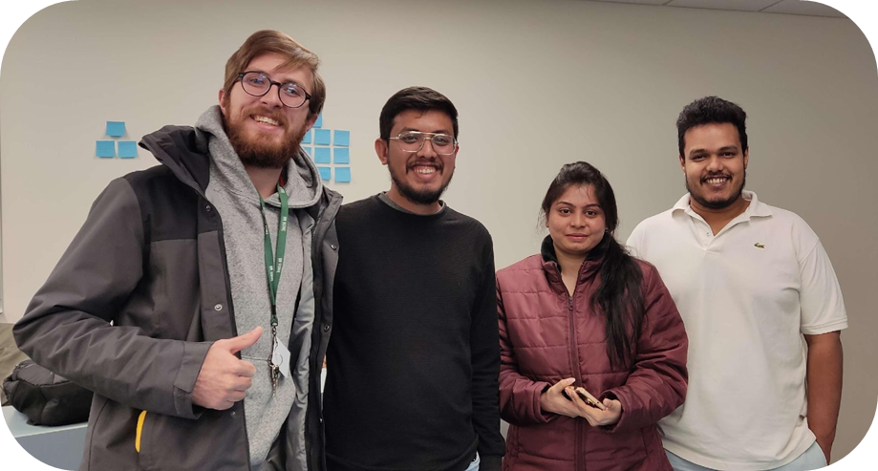
Thank you
SnapPapers

